Slide 1

ORGANIZATIONAL STRUCTURE

Slide 2
Introduction
An organization structure is a result of the organising process.
Consists of the various jobs, departments and responsibilities in the enterprise coupled with the definition of the extent of control, management and authority.
Consists of the relationships between various members of the enterprise.

Slide 3
MEANING OF ORGANIZATIONAL STRUCTURE
It defines the scope of acceptable behaviour within an organization
Its lines of authority and accountability
And to some extent organization’s relationship with its external environment.
This highlights the levels of management in an enterprise and allows for correlation and coordination among individuals

Slide 4
Significance
It facilitates growth and changes within an enterprise.
As a matter of fact, an enterprise with a static structure and thus resistance to change can soon go out of fashion in the dynamic business world.
Thus it is important to realise that an enterprise needs a change in the organisation structure whenever it expands and grows in complexity

Slide 5
DEFINITIONS OF ORGANIZATION STRUCTURE
Structure “ is the internal differentiation and patterning of relationships”
- THOMPSON
“ Structure is to be found in an interrelated set of events which return to complete and renew the cycle if activities “
-KATZ and KAHN
Structure “ is the relatively enduring allocation of work roles and administrative mechanisms that creates a pattern of interrelated work activities and allows the organizatrion to conduct , coordinate and control the its work actrivities “
- JACKSON and MORGAN

Slide 6
ORGANIZATIONAL DESIGN
Organization design defines how job tasks are formally divided , grouped and coordinated.
Specifically , there are six key elements that managers need to address when they design an organizational structure.

Slide 7
KEY ELEMENTS OF ORGANIZATION STRUCTURE DESIGN
Work specialization
Division of Department
Chain of command
Span of control
Formalization

Slide 8
1.WORK SPECIALIZATION
It describes the degree to which tasks in an organization are divided into separate jobs.
The main idea of this organizational design is that an entire job is not done by one individual. It is broken down into steps, and a different person completes each step. Individual employees specialize in doing part of an activity rather than the entire activity.
It may also be termed as DIVISION OF LABOUR

Slide 9
2.DIVISION OF DEPARTMENT
It is the basis by which jobs are grouped together.
For instance every organization has its own specific way of classifying and grouping work activities.
There are five common forms of departmentalization:
DEPARTMENTALIZATION
FUNCTIONAL PRODUCT GEOGRAPHICAL PROCESS CUSTOMER

Slide 10
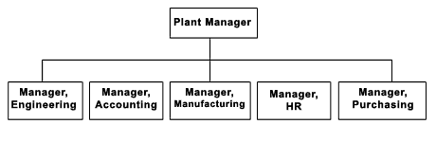
FUNCTIONAL DEPARTMENTALIZATION
It groups jobs by functions performed.
It can be used in all kinds of organizations; it depends on the goals each of them wants to achieve.
For example:-

Slide 11
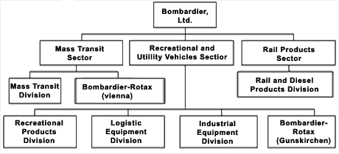
PRODUCT DEPARTMENTALIZATION
It groups jobs by product line. Each manager is responsible of an area within the organization depending of his/her specialization
For example :-

Slide 12
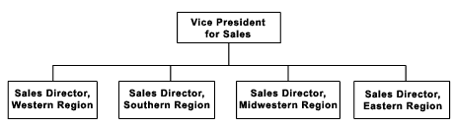
GEOGRAPHICAL DEPARTMENTALIZATION
It groups jobs on the basis of territory or geography.
For example:-

Slide 13
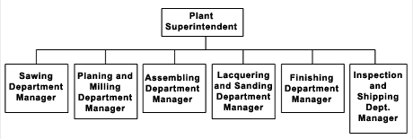
PROCESS DEPARTMENTALIZATION
It groups on the basis of product or customer flow.
For example:-

Slide 14
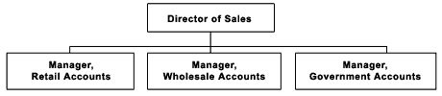
CUSTOMER DEPARTMENTALIZATION
It groups jobs on the basis of common customers.
For example:-

Slide 15
3.CHAIN OF COMMAND
It is defined as a continuous line of authority that extends from upper organizational levels to the lowest levels and clarifies who reports to whom.
There are three important concepts attached to this theory:
Authority: Refers to the rights inherent in a managerial position to tell people what to do and to expect them to do it.
Responsibility: The obligation to perform any assigned duties.
Unity of command: The management principle that each person should report to only one manager.

Slide 16
4.SPAN OF CONTROL
It is important to a large degree because it determines the number of levels and managers an organization has.
Also, determines the number of employees a manager can efficiently and effectively manage.

Slide 17
5.FORMALIZATION
It refers to the degree to which jobs within the organization are standardized and the extent to which employee behavior is guided by rules and procedures.
HIGH LEVELS | LOW LEVELS
minimum amount of discretion over what, when, and how consistent output explicit job descriptions organizational rules clearly defined procedures | unprogrammed behaviors exercise discretion great deal of freedom less standardization consider alternatives

Slide 18


